Slide 1
RAILWAY TRAIN ENQUIRY SYSTEM
INTRODUCTION
The Railway Train Enquiry system is an online enquiry system that is developed for solving customer problem related to train about its information like train name ,number ,time table, and service days. It also includes various types of payment method for customer to choose.

Slide 2
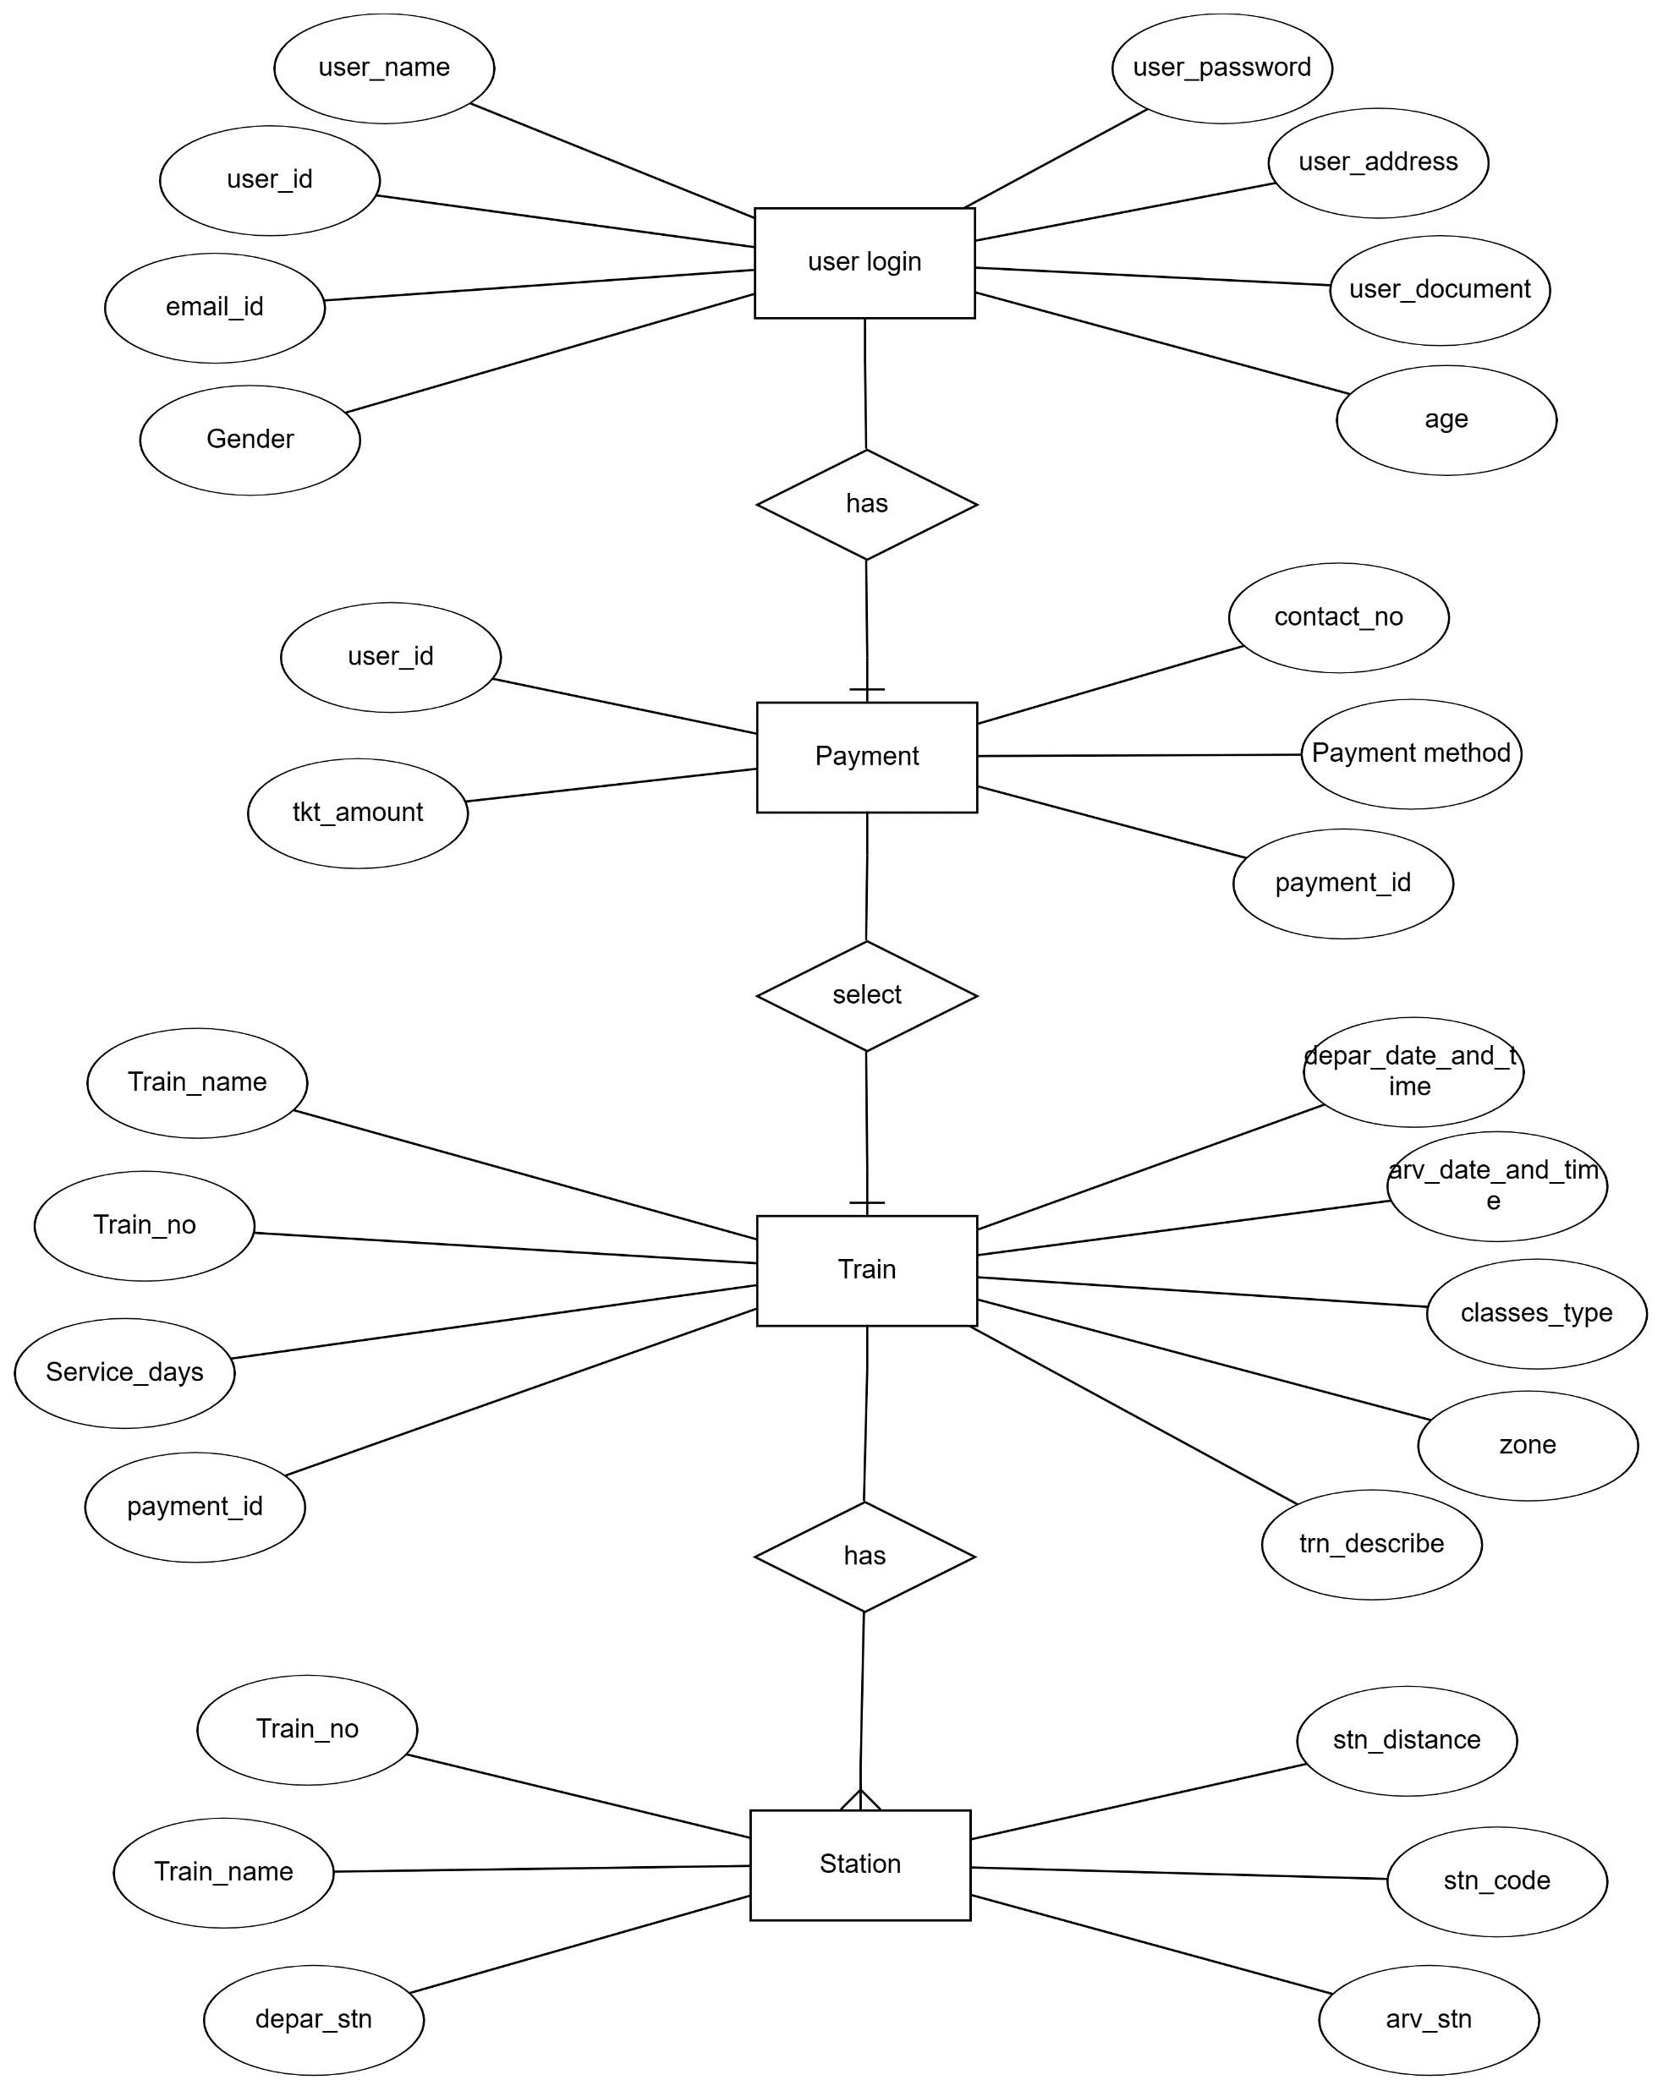
ERD DIAGRAM:

Slide 3
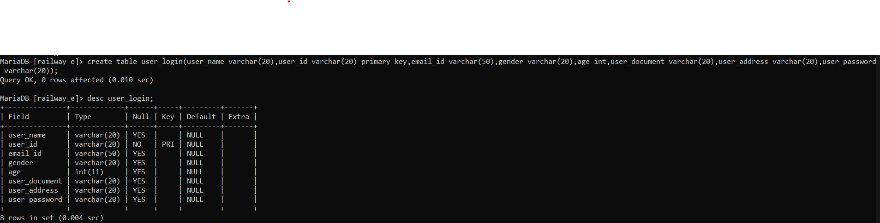
STRUCTURE OF TABLES
1)USER _LOGIN: In this table contents all the information of user need to login:

Slide 4
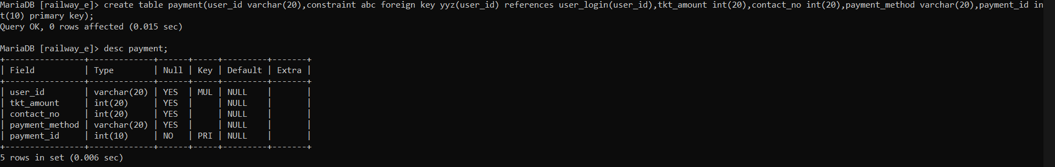
2)Payment
In this table given the information related to payment that how user can do fare payment to railway

Slide 5
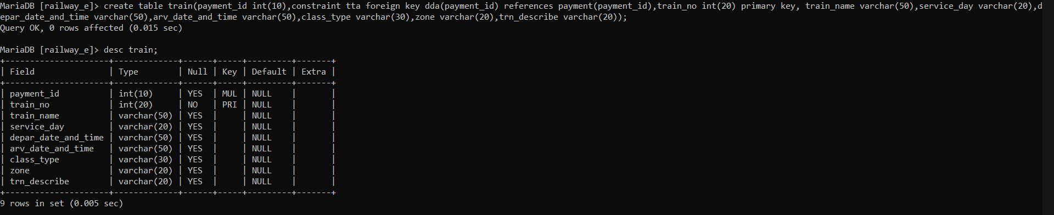
3)Train
In this table given the information about train

Slide 6
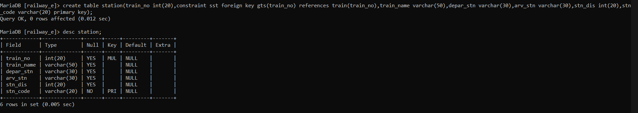
4)station:
In this table given all the details of station.

Slide 7
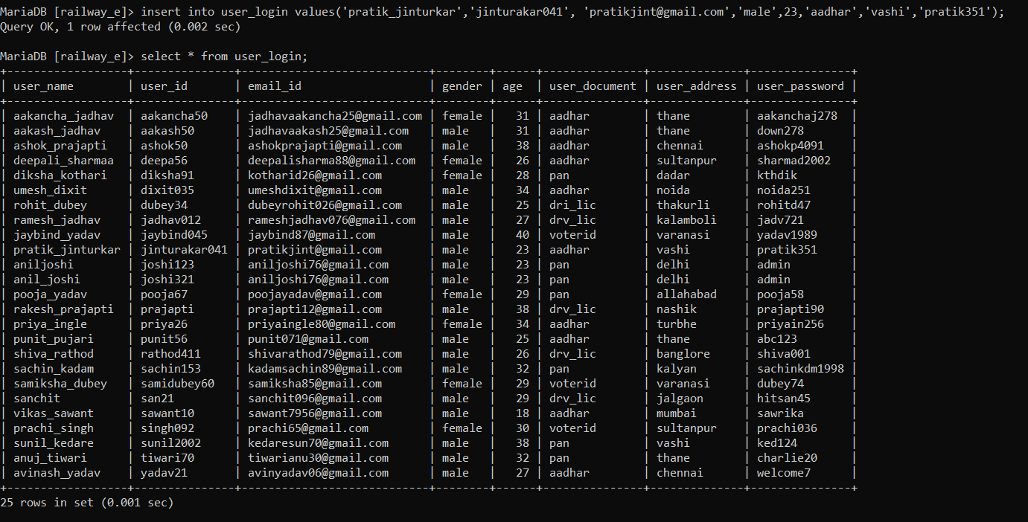
CONTENTS OF TABLES
USER_LOGIN :

Slide 8
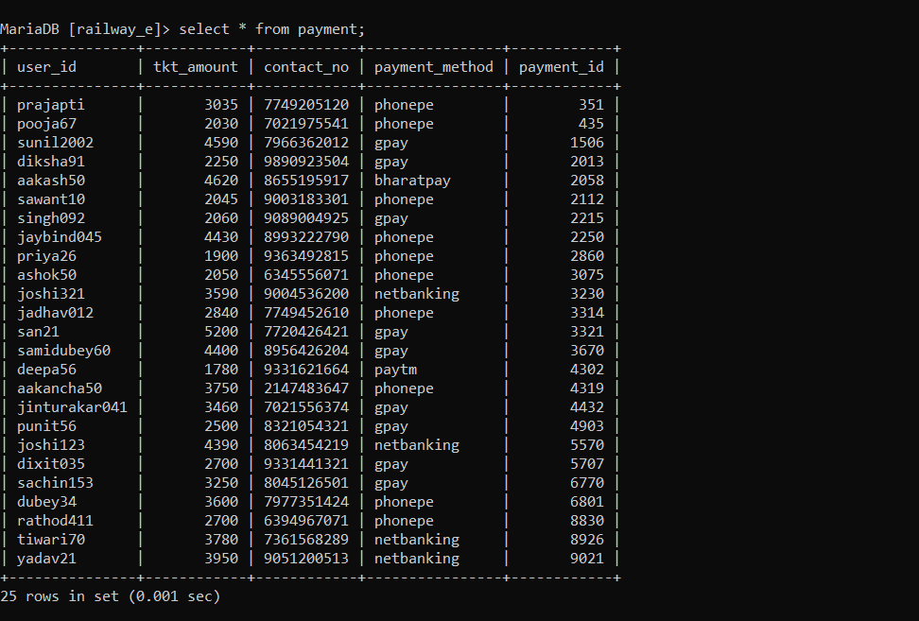
Payment :

Slide 9
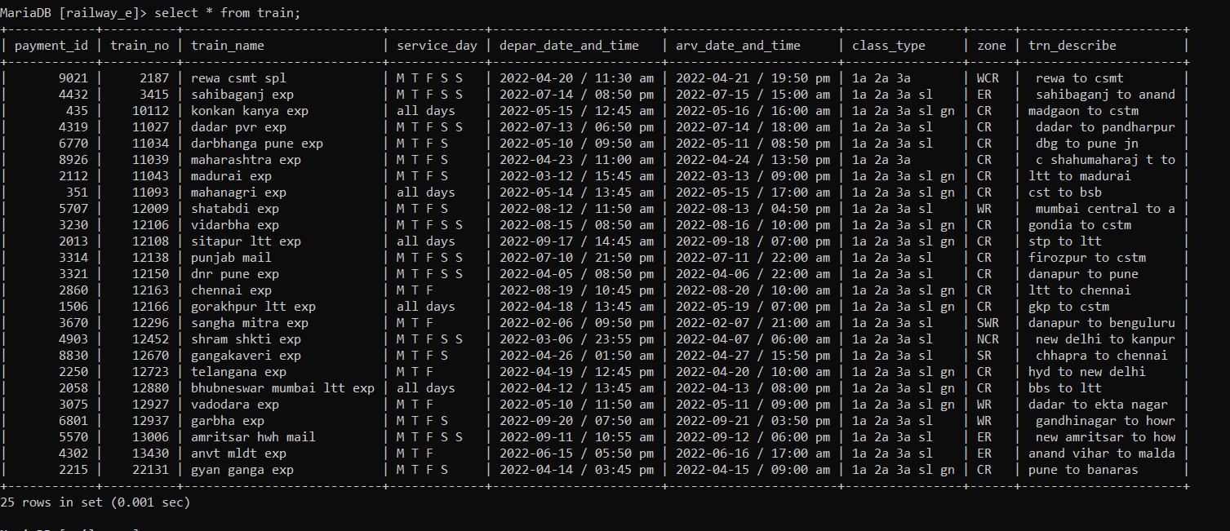
train

Slide 10
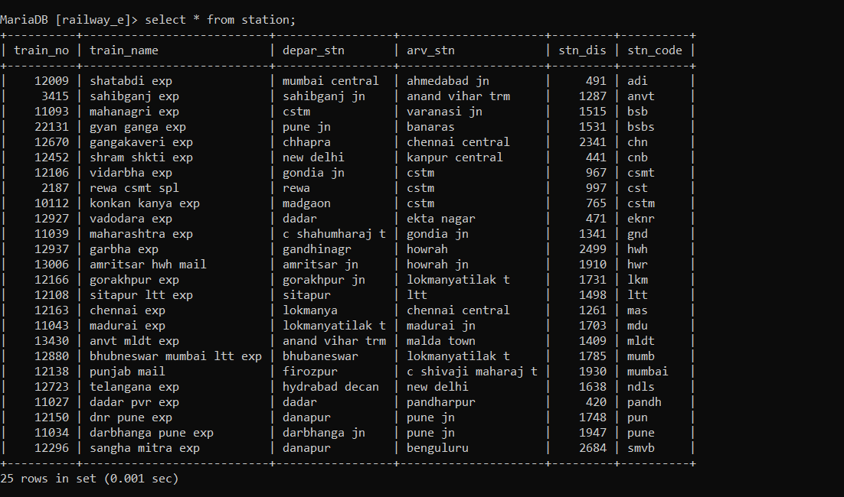
station

Slide 11
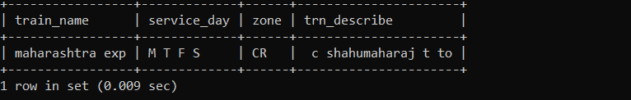
SUBQUERIES 1)Show the details of train where train_name=“Maharashtra exp”?
MariaDB [railway_e]> select train_name,service_day,zone,trn_describe from train where train_no in(select train_no from station where train_name="maharashtra exp");

Slide 12
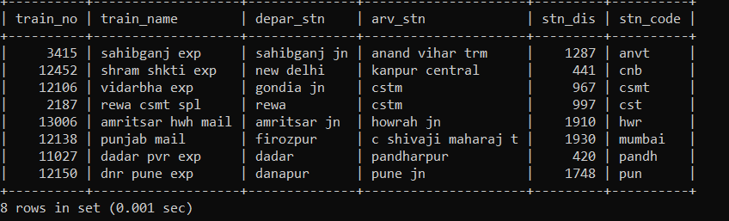
2)Show all the details of station where service day =“MTFSS”?
MariaDB [railway_e]> select * from station where train_no in(select train_no from train where service_day="M T F S S");

Slide 13
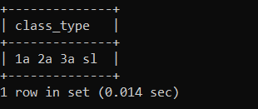
3)Show class type of the train using user name?
MariaDB [railway_e]> select class_type from train where payment_id in(select payment_id from payment where user_id in(select user_id from user_login where user_name="rohit_dubey"));

Slide 14
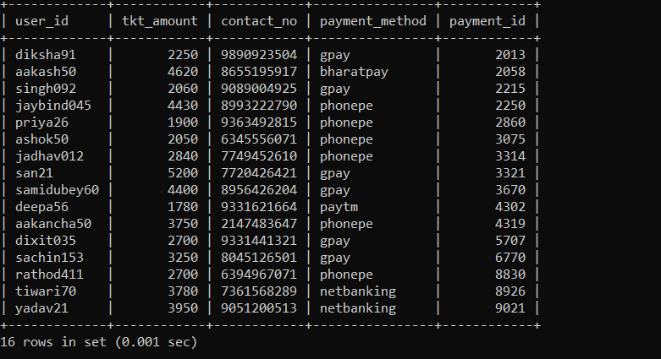
4)Show all the details of payment where age is more than 25 and having payment id greater than 2000?
MariaDB [railway_e]> select * from payment where user_id in(select user_id from user_login where age>25) having payment_id>2000;

Slide 15
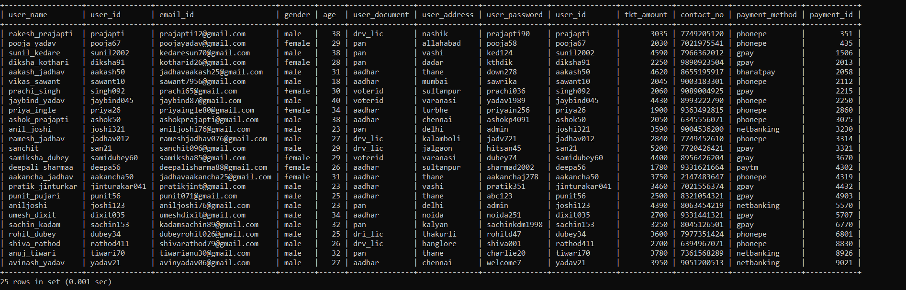
JOINS 1) join table user_login and payment.
MariaDB [railway_e]> select * from user_login inner join payment on user_login.user_id=payment.user_id;

Slide 16
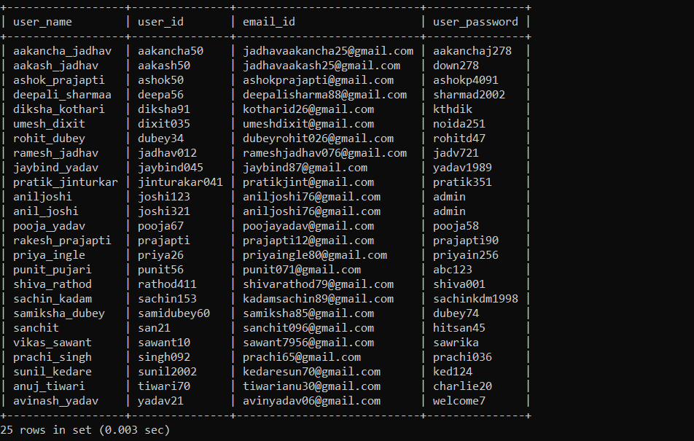
2)left join the user_login table.
MariaDB [railway_e]> select user_login.user_name,user_login.user_id,user_login.email_id,user_login.user_password from user_login left join payment on user_login.user_id=payment.user_id;

Slide 17
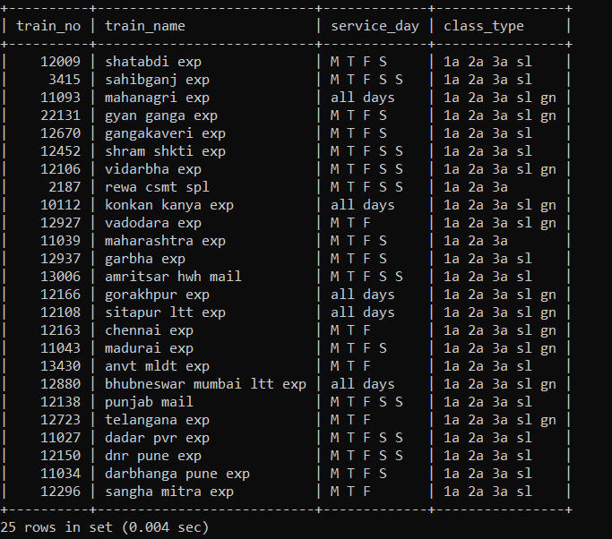
3) Right join train and station table.
MariaDB [railway_e]> select train.train_no,station.train_name,train.service_day,train.class_type from train right join station on train.train_no=station.train_no;

